Slide 1
The cell biology lab 3
Preparation of permanent slides

Slide 2
Preparation of permanent slides
There is no single recipe for making a permanent slide, as the preparation process depends much on the
1- Nature of the specimen.
2- The mounting medium used.
We give a generic overview of the process, which has to be adapted to the specific specimen.

Slide 3
Method
Fixing: This kills the cells and preserves the specimen as well as prepares the specimen for staining.
The fixing solution is water-based and a wide range of different solutions exists.

Slide 4
Types of chemical fixing agents
1- Alcohol and acetic acid: This combination denatures proteins.
2- Aldehydes (such as formaldehyde): these react with amino groups in the specimen.
3- Oxidation agents: these react with lipids.
4- Tanning agents: react with proteins and with amino groups.

Slide 5
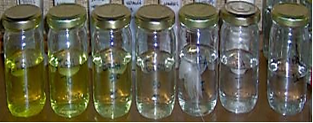
- Dehydration: The water in the specimen is slowly removed by placing it into subsequently higher concentrations of alcohol. Ex: ( Ethyl alcohol , Methyl
.alcohol )

Slide 6
- Infiltration or clearing: The alcohol is removed and replaced with a solvent, which is compatible to the embedding medium (usually paraffin). Often xylene is used.
- Embedding: The specimen is now embedded into paraffin, the paraffin block supports the specimen during microtoming.

Slide 7
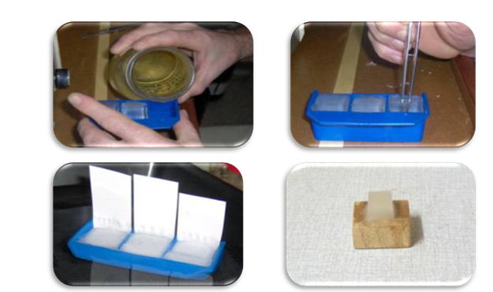

Slide 8
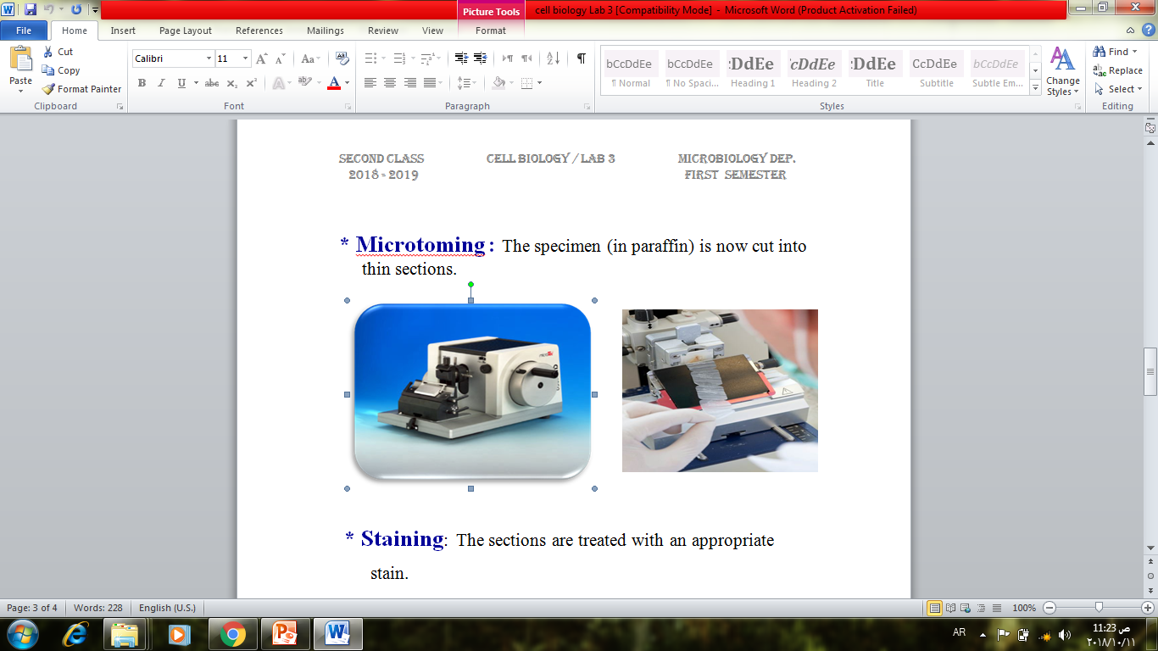
-Microtoming : The specimen (in paraffin) is now cut into thin sections.

Slide 9
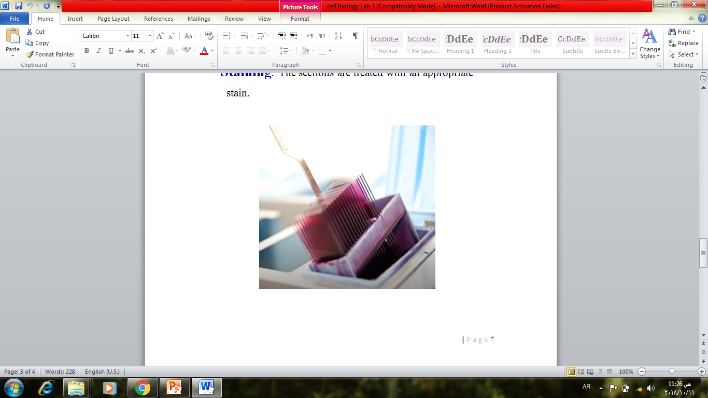
- Staining: The sections are treated stain

Slide 10
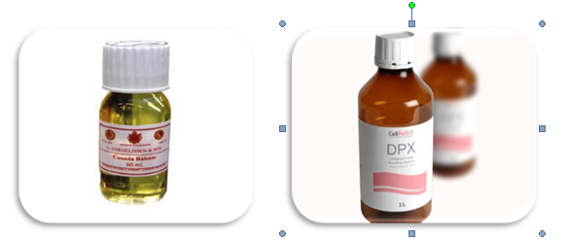
-Mounting: The specimen is then mounted in appropriate mounting medium.

Slide 11
